Slide 1
Jefferson High School Booster Club Meeting 3/13/23

Slide 2
JHS Booster Club Mission Statement
“The Jefferson High School Booster Club is committed to inclusive, courageous student activities that compete for excellence in lifelong learning. The JHS Booster Club supports student activities through funding resources, school pride and community spirit and support.”

Slide 3
JHS Booster Club Agenda
March Agenda
Michelle Jensen
JHS Best Buddies
Tim Reck
Boys Basketball
Nominations for Board
Financials
Teacher’s Celebration: April 6, 2023
Miscellaneous Updates
April 10 Booster Meeting will need to be moved, due to Easter Monday

Slide 4
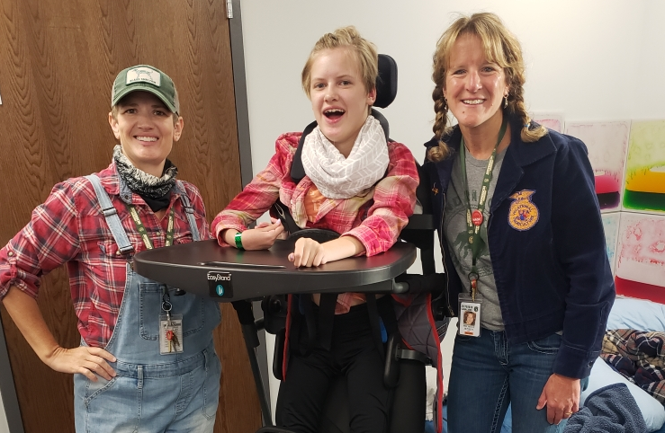
Updates from Coaches/Directors
Michelle Jensen –
JHS Best Buddies/Unified Sports
https://docs.google.com/presentation/d/15V-cUyWG5u_mEu2zzLPaYjjUS8dSNG-ULlJXuuoCf4o/edit?usp=sharing

Slide 5
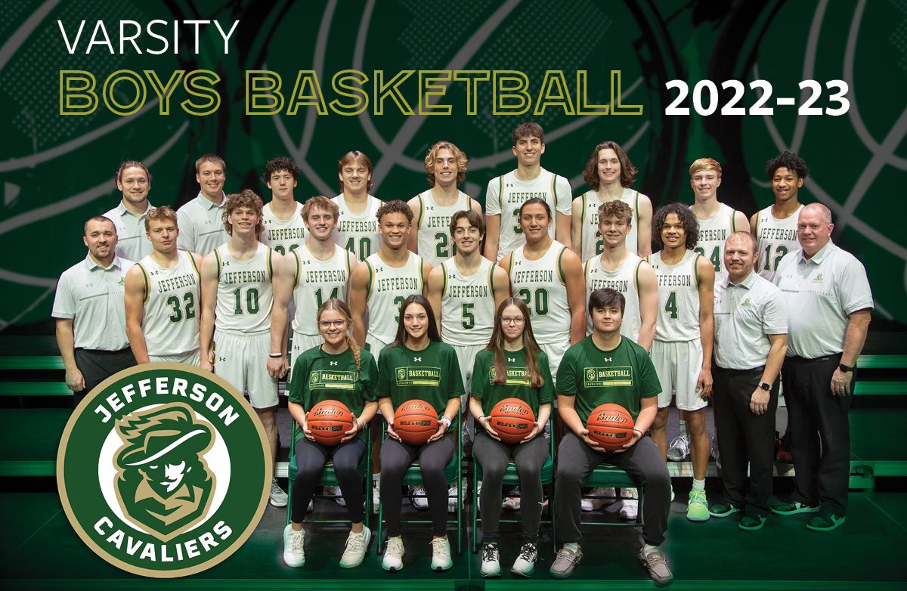
Updates from Coaches/Directors
Tim Reck –
Boys Basketball

Slide 6
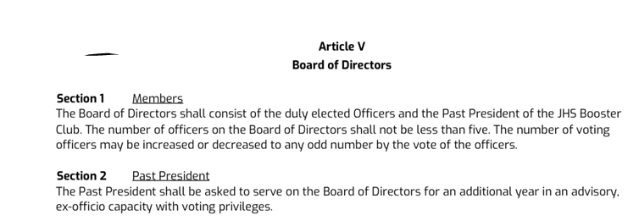
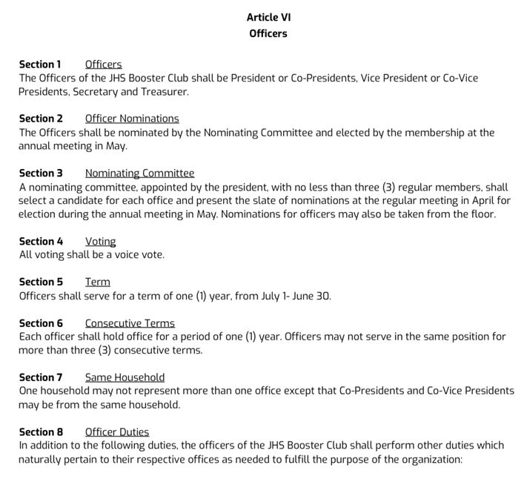
New Board Members

Slide 7
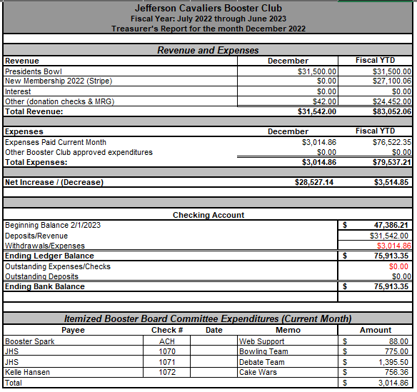
JHS Booster Club Financials

