Slide 1
Jefferson High School Booster Club Meeting 1/9/23

Slide 2
JHS Booster Club Mission Statement
“The Jefferson High School Booster Club is committed to inclusive, courageous student activities that compete for excellence in lifelong learning. The JHS Booster Club supports student activities through funding resources, school pride and community spirit and support.”

Slide 3
JHS Booster Club Agenda
January Agenda
Coach/Director Updates
Todd Wells – Wrestling
Steve Hirsch – Boys Soccer/Theatre
Travis Dahle – Debate
Ed Whiting – Softball
Financials
Miscellaneous Updates
Presidents Bowl

Slide 4
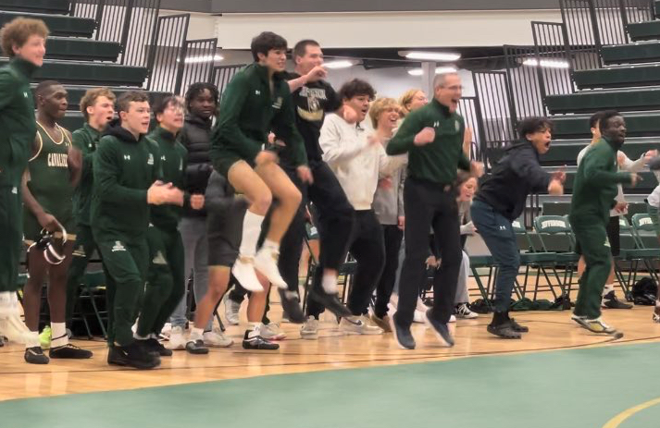
Updates from Coaches/Directors
Todd Wells – Wrestling

Slide 5
Updates from Coaches/Directors
Steve Hirsch – Boys Soccer/Theatre

Slide 6
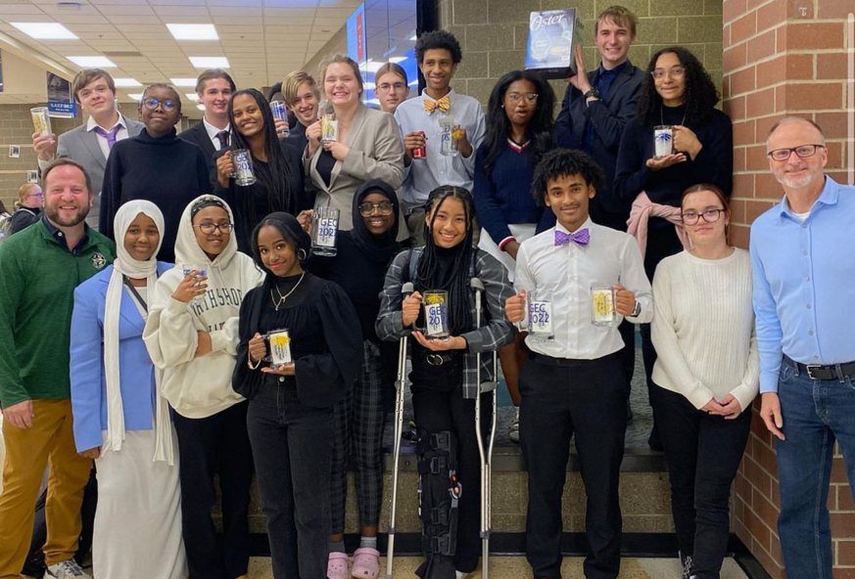
Updates from Coaches/Directors
Travis Dahle – Debate

Slide 7
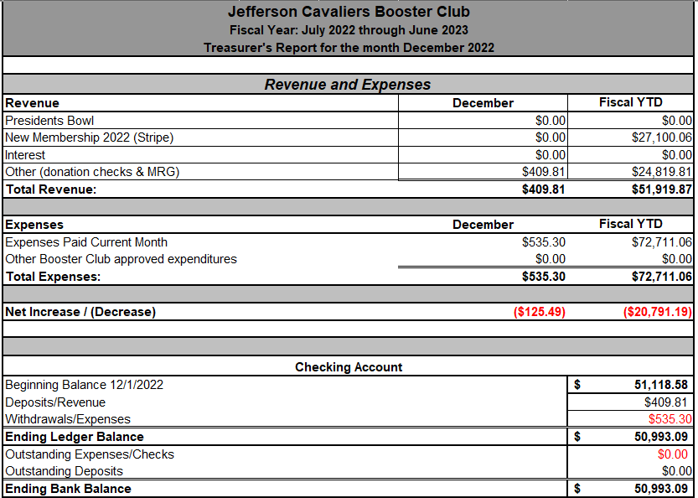
JHS Booster Club Financials

