Slide 1
Jefferson High School Booster Club Meeting 11/14/22

Slide 2
JHS Booster Club Mission Statement
“The Jefferson High School Booster Club is committed to inclusive, courageous student activities that compete for excellence in lifelong learning. The JHS Booster Club supports student activities through funding resources, school pride and community spirit and support.”

Slide 3
JHS Booster Club Agenda
November Agenda
Cake Wars –
Date – January 21st
Basketball Doubleheader vs Huron
Financials
2021 taxes have been filed
Teachers Celebration – Date TBD – March/April

Slide 4
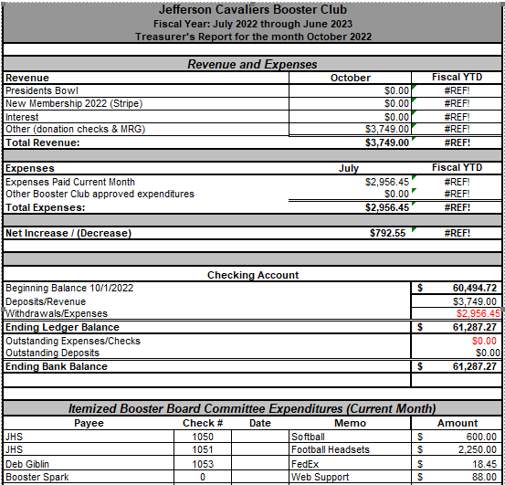
JHS Booster Club Financials

