Slide 1
Jefferson High School Booster Club Meeting 9/12/22

Slide 2
JHS Booster Club Mission Statement
“The Jefferson High School Booster Club is committed to inclusive, courageous student activities that compete for excellence in lifelong learning. The JHS Booster Club supports student activities through funding resources, school pride and community spirit and support.”

Slide 3
JHS Booster Club Agenda
September Agenda
Introductions of current board members
Home Attendance Center – Communications Guidelines – Lance Siebenahler(Slide 4/5)
Booster Club Announcements
21–22-year end disbursements (Slide 6)
Attendance expectations
Special requests for funds
Committees to fill – need of booster members/parent reps to lead
Special Events/Care Committee
Celebrations
Signing Days
Championship Celebrations
Awards Nights
Injured or ill students or family members
Cake decorating events
Futures Nights $150 limit from the booster club
Need receipts
Financials (Slide 7)
Presidents Bowl Update – Mike Brenna
Monday October 10th meeting will be moved

Slide 4
High School Home Attendance Schools
SFSD – High School Home Attendance Schools
High School | Lincoln | Jefferson | Roosevelt | Washington
Middle School Associated w/HS | Patrick Henry | McGovern | Edison | Ben Reifel
 | Whittier | Memorial | Memorial | Whittier
Elementary School Associated w/HS | Eugene Field | Discovery | Garfield ½ | Anne Sullivan
 | Hawthorne | Garfield (1/2) | Jane Addams | Cleveland
 | Jane Addams | Hayward | JFK | Harvey Dunn
 | John Harris ½ | Jane Addams | Laura Wilder | Jane Addams
 | LBA ½ | Lowell ½ | Lowell ½ | John Harris ½
 | Robert Frost | Renberg ½ | Oscar Howe | LBA ½
 | Sotomayor |  | Pettigrew | Renberg ½
 | SBA |  |  | Rosa Parks
 | Terry Redlin
Spanish Immersion: The Spanish Immersion program courses are offered at Lincoln High School. Lincoln High School coaches may contact Spanish Immersion students, however, may not visit Edison for communication purposes. Jefferson and Washington High School coaches may contact their HAC Spanish Immersion students, however, may not visit Edison for communication purposes. Roosevelt High School coaches may visit Edison for communication purposes.
Honors Program: Jefferson, Roosevelt and Washington High School coaches may contact honors students in their HAC, however, may not visit Patrick Henry for communication purposes. Lincoln High School coaches may visit Patrick Henry for communication purposes.

Slide 5
High School Home Attendance Schools
Following are the Home Attendance Center (HAC) schools and families
If the booster club wants/needs to distribute information to students/families/schools, please work through Chad’s office
They have all the contact information and will send it out
Policy Guidelines:
Communication
All communication with elementary & middle schools in the SFSD will have to go through the respective High School Activities office
The office will have an approved HAC distribution list
Future Cavalier, Patriot, Rider and Warrior Newsletters
If these newsletters are organized, they will be done by the respective High School Activities office
NO advertising in elementary or middle school newsletters or asking elementary and/or middle school administrators to send information out to their families
This includes hanging up flyers or locker signs

Slide 6
Disbursements/Attendance/Special Requests
Booster club’s intent is to provide support to all activities & appropriate funds in a timely manner
Disbursements to level 4/3 activities
$1,500 per activity
Totaling $40,500
Disbursements to level 2 activities
$300 per activity
Totaling $3,900
The club will assess available funds at the end of the fiscal year for disbursements
Attendance expectations
Activities leaders/coaches establish parent reps to attend meetings
Each activity must be represented in the meetings at least 8 of 10 meetings to receive funding
$100 drawing each month (must be present)
Special requests for funds
2 times during the school year
September and January each year
Approved requests from Chad/Dan

Slide 7
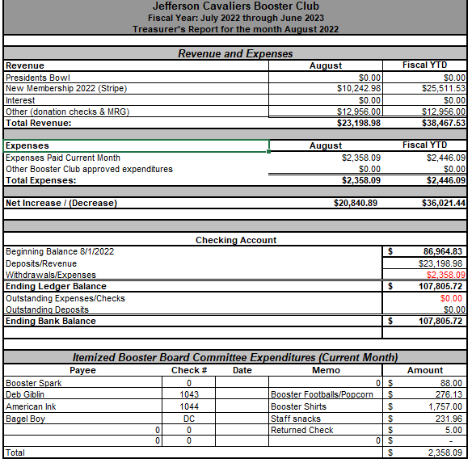
JHS Booster Club Financials

